Slide 1
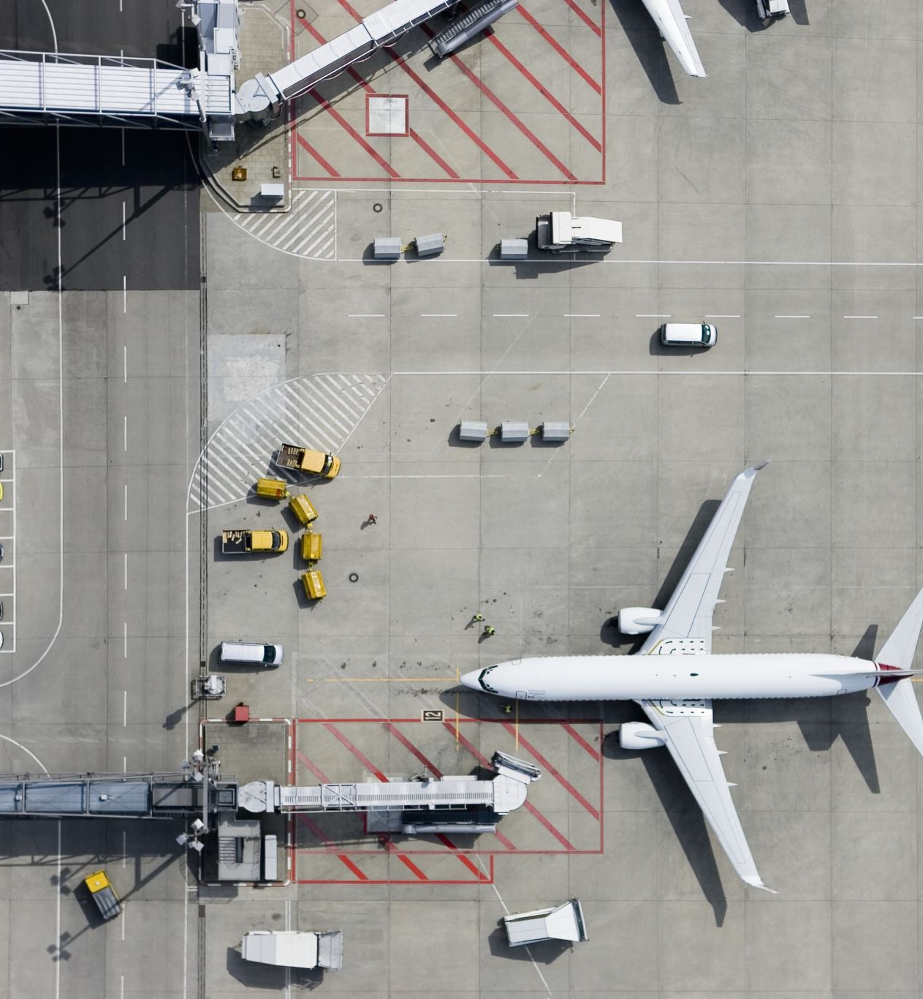
DATA 601 Final Project
Analyzing and Visualizing Flight Delays Dataset for year 2019 (before covid)
Group 13
James Ding
Misha Salykova

Slide 2

Domain Introduction Analyzing and visualizing flight delays in the Aviation Industry: Why is it important?
Customer Satisfaction & Loyalty
Operational Efficiency
Cost Management
Safety and Compliances
Strategic Planning and Scheduling
Risk Management
Competitive Advantage
Visual Communication

Slide 3
Dataset
Flight Delay and Cancellation Dataset (2019-2023)
Source: Kaggle (origin: data was collected by the US Department of Transportation, Bureau of Transportation Statistics )
Format: csv
Original sample size = 1,048,576 flights
Note: The focus of our analysis will the be year 2019 data, in order to correctly visualize the population statistics before the covid pandemic during regular operations without restrictions

Slide 4

Guiding questions
1. How do delays vary by time of day, day of the week, or season?
2. Are certain airlines more prone to flight delays?
3. Are certain airports more prone to delay?
5. Do airtime and distance affect flight delays?
4. What are the major factors causing flight delays?

Slide 5
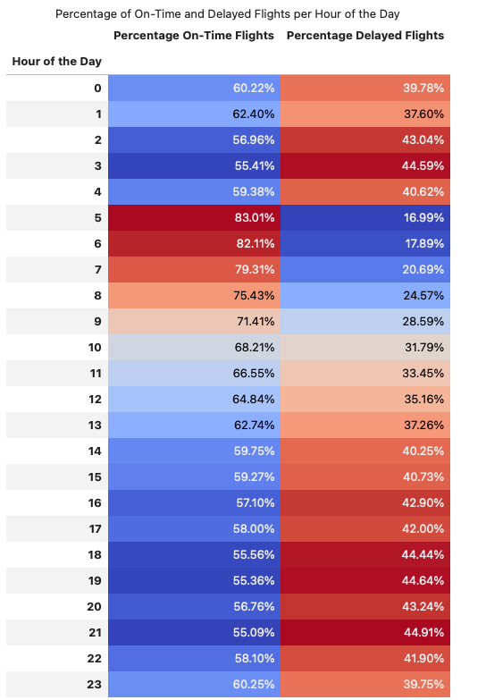
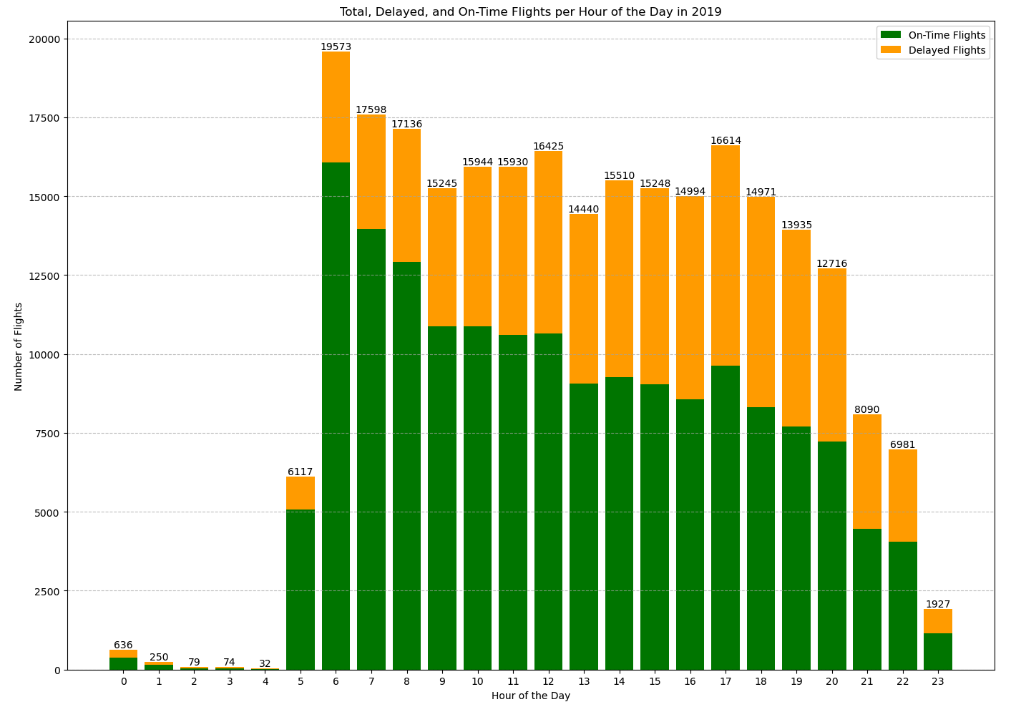
1.1 How do delays vary by time of day (hour of the day) ?
Findings:
Peak Hours of Delay: the time of the day with the highest number of flights and highest number of delays is from 6:00 am to 8:00 pm.
Early Morning Hours (0:00 to 4:00): despite the low number of total flights have a high percentage of delayed flights (around 41% on average).
Morning Rush Hours (5:00 to 9:00): on the contrary to early morning hours, we can see that despite the drastic increase in the number of total flights starting at 5:00 am, morning rush hours from 5:00 am to 9:00 am have the lowest percentage of delayed flights (around 22% on average) throughout the day. The time of the day with the highest number of total flights is 6:00 am with 19573 total flights, however 6:00 also has the second lowest percentage of delayed flights per hour 17.89%.
Midday to Afternoon (10:00 to 15:00): As the day progresses, the percentage of delayed flights gradually increases, peaking around 15:00 (40.73%).
Evening Hours (16:00 to 23:00): The percentage of delayed flights increases further and remains relatively high (around 42.5 % on average) during the evening hours, peaking at 18:00 (44.44%).
Note*: overall, average delay time (minutes) stays relatively constant at around 30-50 minutes throughout the entire day, only peaking during certain early morning hours.

Slide 6
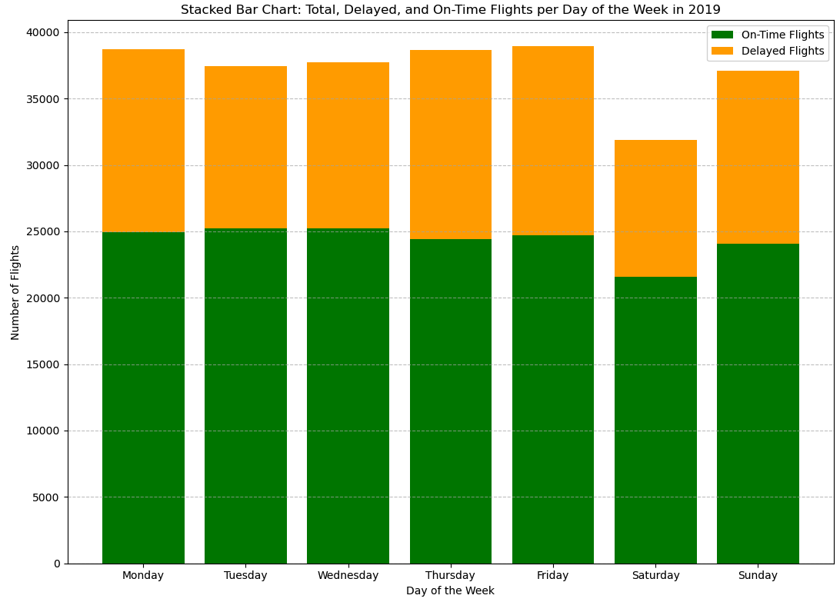
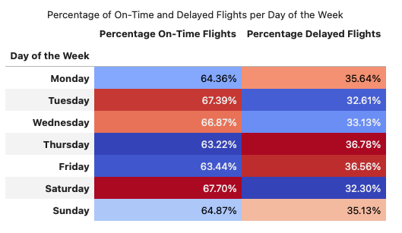
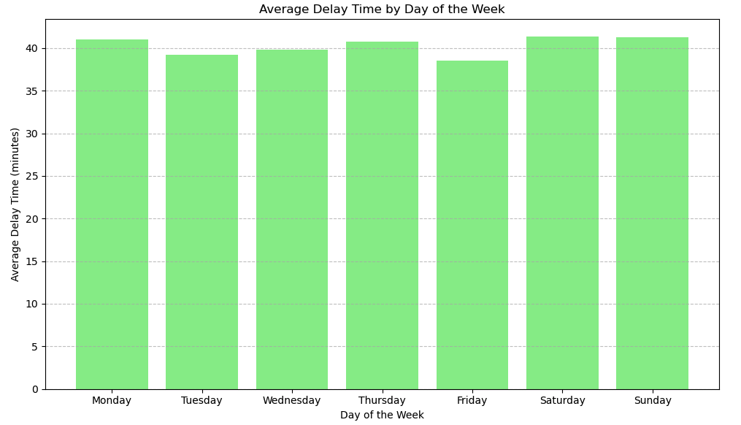
1.2. How do delays vary by Day of the Week?
Findings:
There seems to be no significant difference between the percentage of delayed flights throughout the week. All days of the weeks have similar percentages of delayed flights (32-36%).
The average delay time (minutes) is also comparable for all days of the week at around 40 minutes.

Slide 7
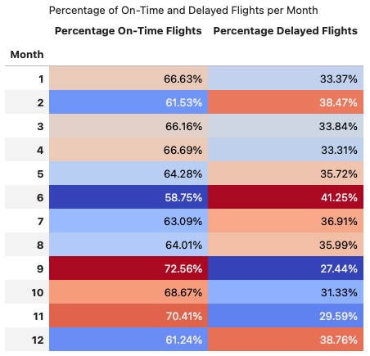
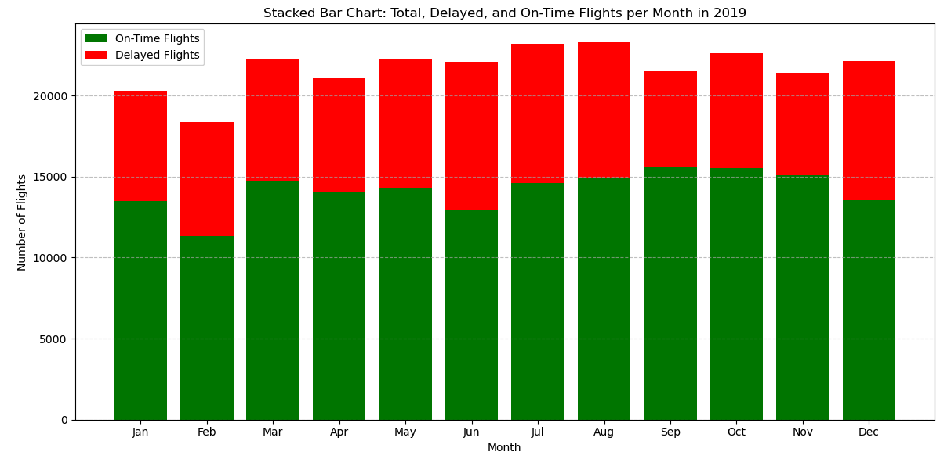
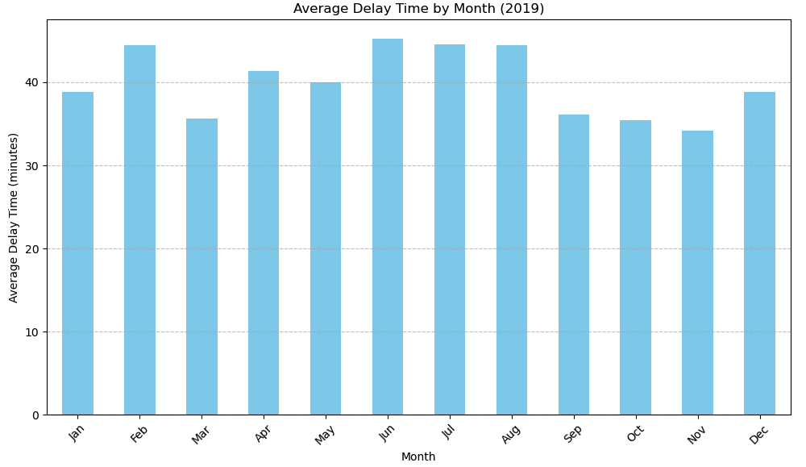
1.3 How do delays vary by Month of the Year?
Findings:
Overall, we can see that all months have comparable numbers of total flights, on-time flights, and delayed flights.
Fall months have a slightly higher overall percentage of on-time flights (Sep 72.56%, Oct 68.67%, Nov 70.41%) & lower percentage of delayed flights (Sep 27.44%, Oct 31.33%, Nov 29.59%)
While some months have a slightly higher percentage of delayed flights (Feb 38.47%, June 41.25%, Dec 38.76%)
Average Delay times throughout the year are relatively constant varying from 35-45 minutes on average.
Months with higher percentages of delayed flights exhibit slightly longer average delay times (Feb, Jun, Dec)
Months with lower percentages of delayed flights exhibit slightly shorter average delay times (Sep, Oct, Nov)

Slide 8
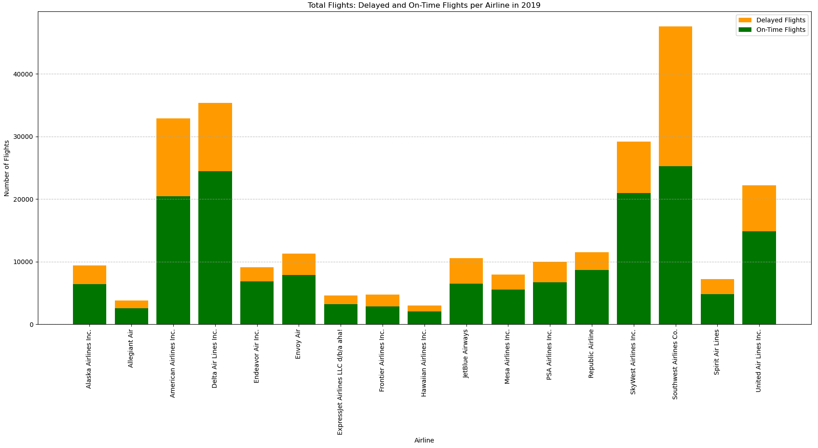
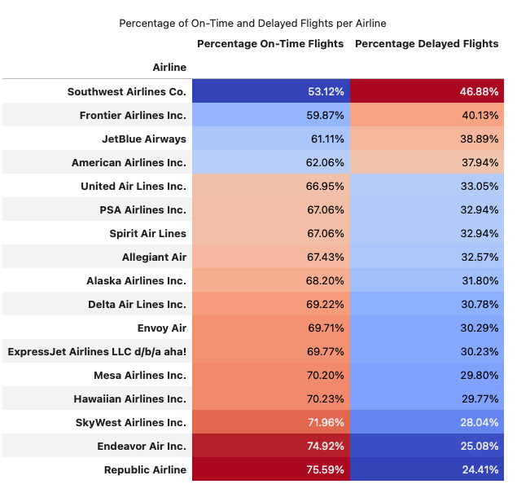
GUIDING QUESTION 2: Are certain airlines more prone to flight delays?
Findings:
- SkyWest Airlines Inc. have the fourth highest number of total flights per year and have a relatively high percentage of on-time flight (above 70%) and relatively low percentages of delayed flights (28.04%), suggesting an outstanding operational efficiency and performance.
- Airlines like Endeavor Air Inc., Republic Airline, and SkyWest Airlines Inc. have relatively high percentages of on-time flights (above 70%), suggesting better punctuality.
- Airlines like Frontier Airlines Inc. and Southwest Airlines Co. have higher percentages of delayed flights (above 40%), indicating a higher likelihood of delays with these carriers.
Findings:
- Southwest Airlines Co. have the highest number of total flights per year; however, they also have the highest percentage of delayed flights (46.88%)
- Delta Air Lines Inc. have the second highest number of total flights per year, and they have average by industry standards percentage of delayed flights (30.78%)
- American Airlines Inc. have the third highest number of total flights per year, and they have higher than average by industry standards percentage of delayed flights (37.94%)

Slide 9
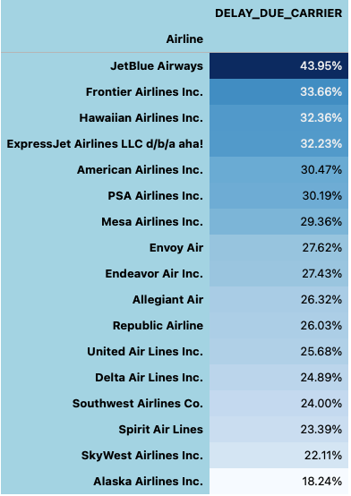
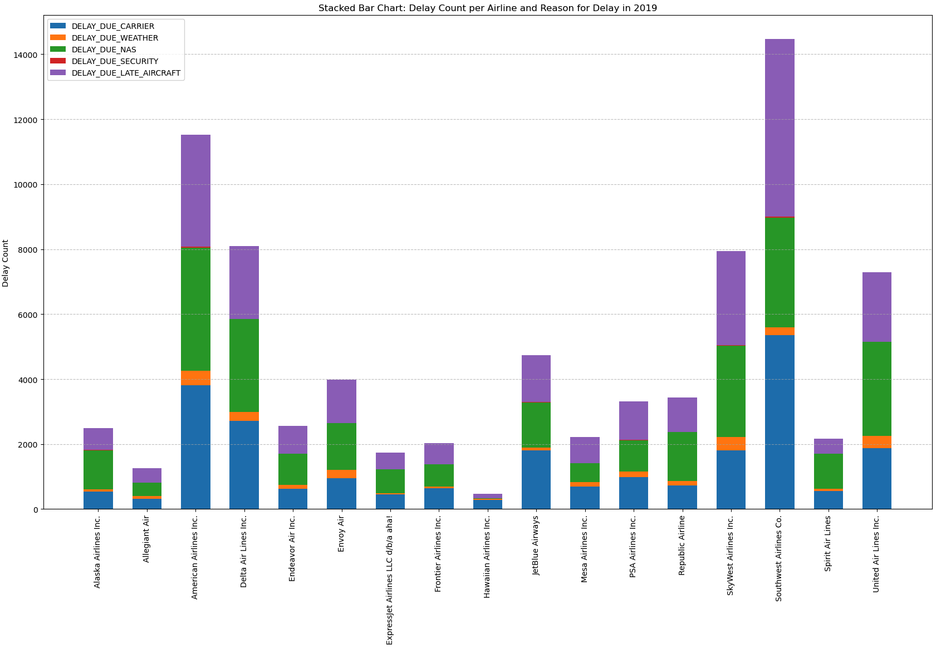
Q2. Are certain airlines more prone to flight delays?
"Delay due to Carrier":
Previously, by looking at the "Percentage of On-Time and Delayed Flights per Airline" we have identified **top 4 airlines with the highest percentage of delays:**
- Southwest Airlines Co. (46.88%)
- Frontier Airlines Inc. (40.13%)
- JetBlue Airways (38.89%)
- American Airlines Inc. (37.94%).
Now let's see what is the percentage of **Delays Due to Carrier** for each of these airlines:
- Southwest Airlines Co. (24.00%) - lower than industry average
- Frontier Airlines Inc. (33.66%) - higher than industry aveage
- JetBlue Airways (43.95%) - highest in the industry percentage of Delays Due to Carrier
- American Airlines Inc. (30.47%) - slightly higher than the industry average
Top 3 reasons of flight delay for all airlines are: Delay due to Late Aircraft, delay due to NAS (national airspace system), Delay due to Carrier.

Slide 10
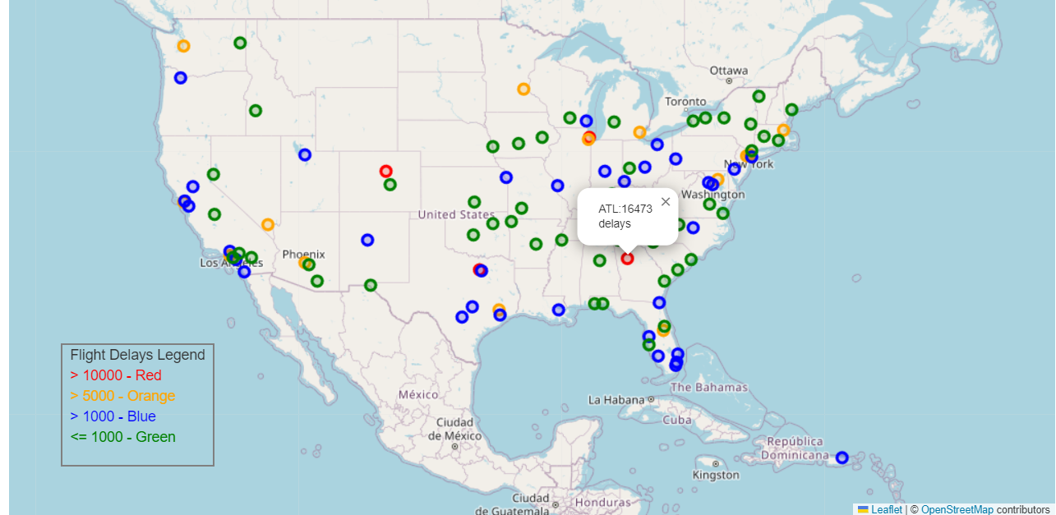
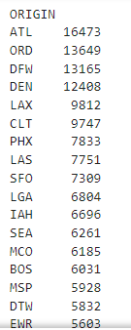
GUIDING QUESTION 3: Are certain airports more prone to flight delays?
Notes:
A picture is worth a thousand words, in order to answer the third guiding question. I utilized geopandas folium function to create a map. To answer the question, according to January 2024 ATCR (Air travel consumer report), there are major factors for certain airports to be prone to delay. Airport Capacity, just sheer amount of flights in ATL or Ohare, weather conditions affecting
New York Airports such as Laguardia & JFK, and many more.
https://www.transportation.gov/resources/individuals/aviation-consumer-protection/january-2024-air-travel-consumer-report

Slide 11
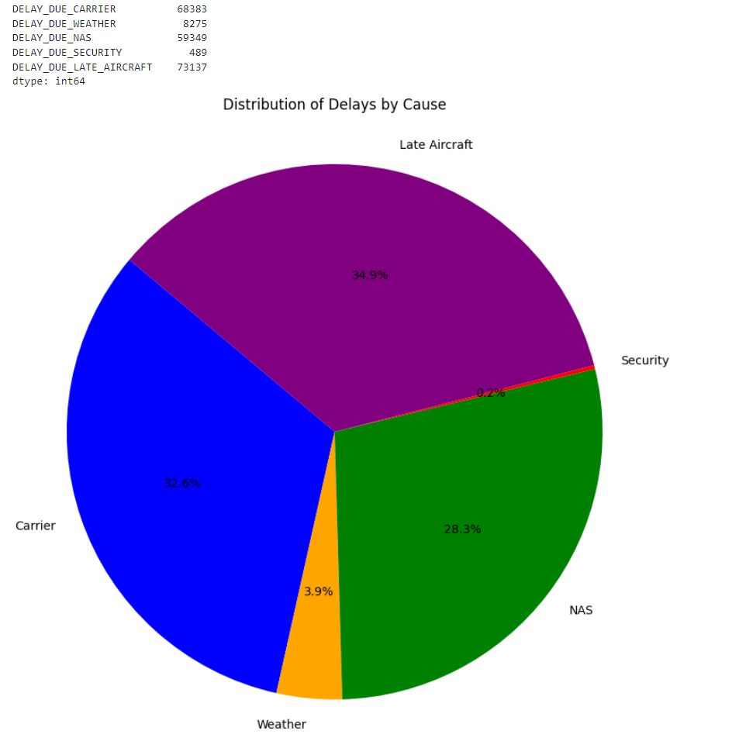
GUIDING QUESTION 4: What are the different causes of delay?
Notes:
Potentially for the “Cause of the delay” I think this question is redundant to the first one
In conclusion, most of the delays are my colleague's fault, they arrived late. (Late Aircraft being the majority of both the count & time of the flight delays)

Slide 12
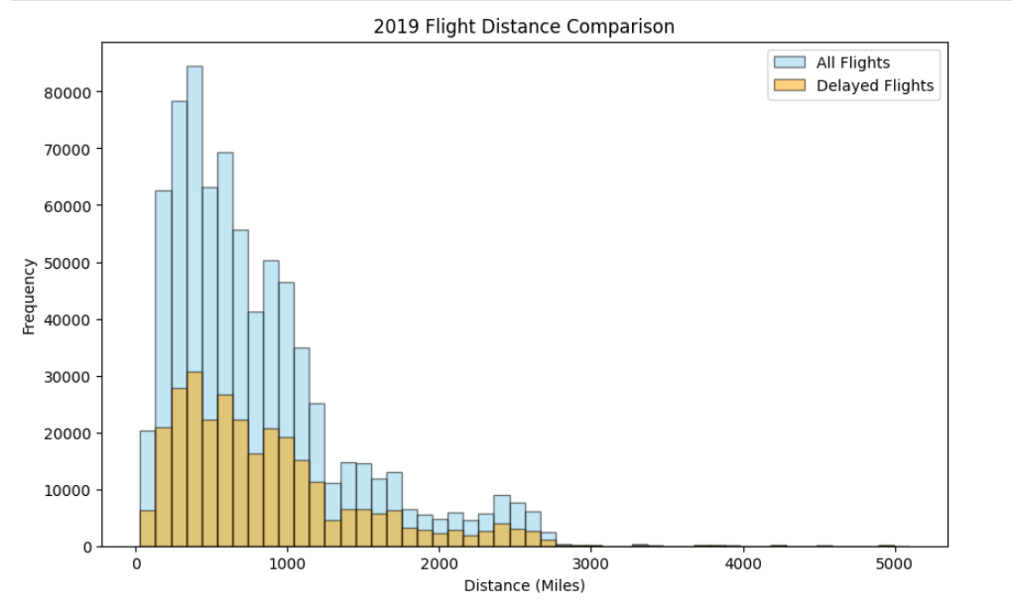
GUIDING QUESTION 5: Do airtime and distance affect flight?
Notes:
Comparison of delayed flights' airtime vs all flights

Slide 13
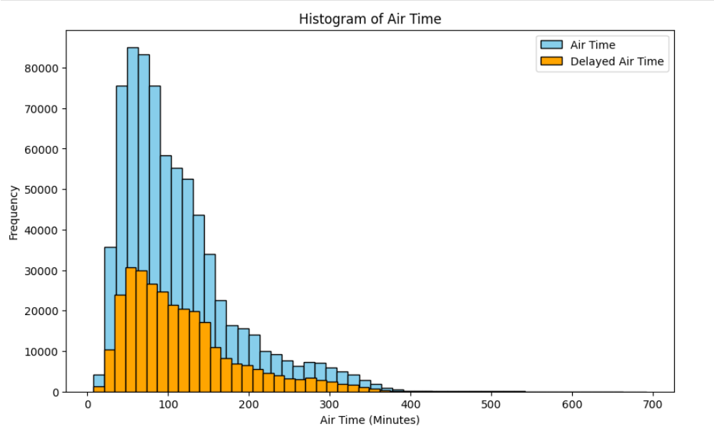
Distance & Air Time

Slide 14
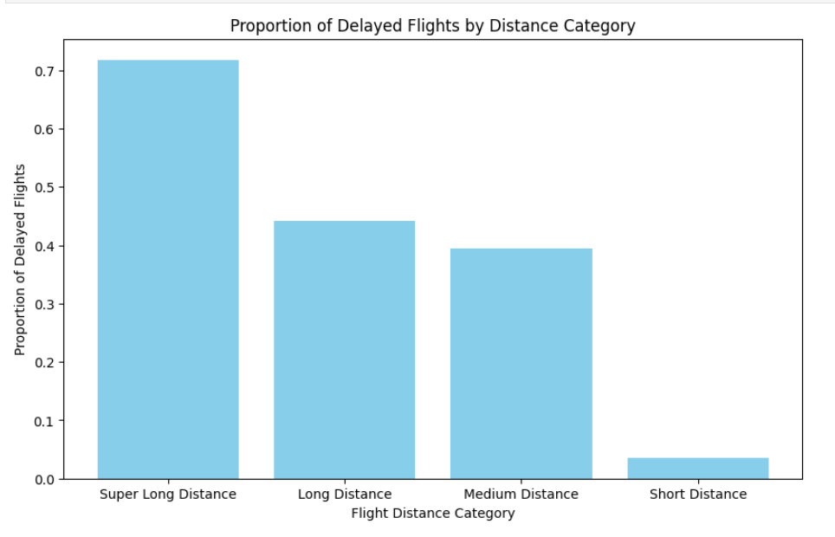
Distance & Air Time
Super long >= 5000
5000 > Long > 1000
1000> Medium > 500
500>= Short
Notes:
In summary, there is a relationship between distance & airtime vs. Flight delays. Super long distance flights tends to have the highest proportion of delayed flights to total flights with a linear relationship going down. One of the major reason is turn time. For example, for YVR, there is a flight to Sydney every night at 22:40 Pacific that requires a lot of preparation with a turn time of an hour and 50 minutes. It is Boening 777 flight from Toronto, AC121 most of the days and that flight delayed most of the days which eats up the preparation time of the flight to Sydney. If you put 2 fueling trucks on arrival, it takes around one hour and 20 minutes and they have to fight their ways to park near the aircraft against groomers, caterers, and AC maintenance & ground crews. Just goes to show long distance flights take a lot of preparations and any factors that could potentially lead to flight delays will lead to flight delays.

Slide 15
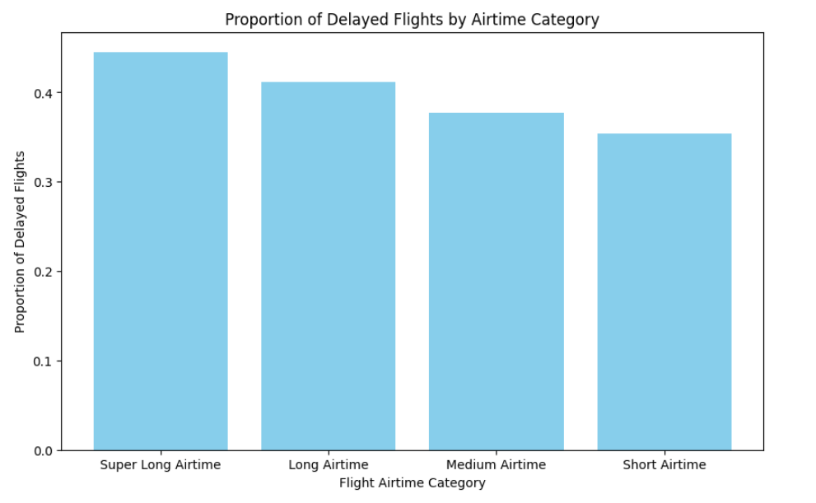
Distance & Air Time
Super long >= 140
140 > Long > 93
93 > Medium > 60
60>= Short

Slide 16
Summary of Findings:
Temporal patterns of delays:
Daily:
Peak Hours of Delay: the time of the day with the highest number of flights and highest number of delays is from 6:00 am to 8:00 pm.
Early Morning Hours (0:00 to 4:00): despite the low number of total flights have a high percentage of delayed flights (around 41% on average).
Morning Rush Hours (5:00 to 9:00): despite the drastic increase in the number of total flights from 5:00 am to 9:00 am have the lowest percentage of delayed flights (around 22% on average) throughout the day
Midday to Afternoon (10:00 to 15:00): the percentage of delayed flights gradually increases, peaking around 15:00 (40.73%).
Evening Hours (16:00 to 23:00): % of delayed flights increases further and remains relatively high (around 42.5 % on average) during the evening hours, peaking at 18:00 (44.44%).
Overall, average delay time (minutes) stays relatively constant at around 30-50 minutes throughout the entire day
Weekly:
No significant difference between the percentage of delayed flights throughout the week. Average % of delayed flights (32-36%).
The average delay time (minutes) is comparable for all days of the week at around 40 minutes.
Monthly:
Fall months have a slightly higher overall percentage of on-time flights (Sep 72.56%, Oct 68.67%, Nov 70.41%)
Months with higher % of delayed flights (Feb 38.47%, June 41.25%, Dec 38.76%)
Average Delay times throughout the year are relatively constant varying from 35-45 minutes on average.
Delays at Certain Airports
Population: Cities with high volume of flights are most likely to experience delay
Infrastructure: Airports with older infrastructure struggled to handle traffic efficiency
Weather: Cities up north often experience flight delays due to weather such as freezing cold and snows that required extra time to de-ice
Personnel: In big airports, the volume of flights sometimes simply is just too much for airport workers to handle. In contrast, in small airports, any absence from its few number of workers could cause delays as well.
Five Major Reasons for Delay
Carrier – 30.3%
Weather – 3.7%
NAS – 33.6%
Security – 0.2%
Latte Arrival Aircraft – 32.3%
Distance & Airtime
Longer Flight: has a higher delay flight to total flight ratio, needs higher preparation times such as baggage, fueling, catering, grooming and more, and the turn time is always the minimum due to delayed arrival flights
Flights covering longer distances or having longer airtime are exposed to weather conditions over a broader area and for a longer period. This increases the likelihood of encountering adverse weather, which can cause delays.
Pilots may need to navigate around bad weather, which can be more challenging on longer routes, potentially leading to delays.
Airlines & delays:
- Southwest Airlines Co. have the highest number of total flights per year; however, they also have the highest percentage of delayed flights (46.88%). However, Delays Due to Carrier (24.00%) - lower than industry average
- Delta Air Lines Inc. have the second highest number of total flights per year, and they have average by industry standards percentage of delayed flights (30.78%)
- American Airlines Inc. have the third highest number of total flights per year, and they have higher than average by industry standards percentage of delayed flights (37.94%)
- SkyWest Airlines Inc. have the fourth highest number of total flights per year and have a relatively high percentage of on-time flight (above 70%) and relatively low percentages of delayed flights (28.04%), suggesting an outstanding operational efficiency and performance

Slide 17
Possible next steps: Descriptive -> Diagnostic -> Predictive -> Prescriptive
As we tread further in our Data Science path, we hope to utilize more techniques and build up on our knowledge such as:
Data Enrichment
Incorporate weather, air traffic and airport operational data in the future to have more meaningful analysis
Advanced Analytics
Incorporate machine learning algorithms to build predictive models for flight delays based on historical data
Enhanced Visualization
More advanced graphs for more efficient and effective visualization and communication of data analysis

Slide 18
References:
Ashmith, Anupkumar. May 2023. INVESTIGATING THE COSTS AND ECONOMIC IMPACT OF FLIGHT DELAYS IN THE AVIATION INDUSTRY AND THE POTENTIAL STRATEGIES FOR REDUCTION. Electronic Theses, Projects, and Dissertations. 1653. Retrieved from https://scholarworks.lib.csusb.edu/etd/1653
2. United States Department of Transportation. (n.d.). Flight Delays and Cancellation dataset. Kaggle. Retrieved from https://www.kaggle.com/datasets/usdot/flight-delays/data
3. United States Department of Transportation. (n.d.). January 2024 Air Travel Consumer Report. Aviation Consumer Protection. Retrieved from https://www.transportation.gov/resources/individuals/aviation-consumer-protection/january-2024-air-travel-consumer-report
4. GeoPandas Developers. (n.d.). Plotting with Folium. GeoPandas 0.10.2 documentation. Retrieved from https://geopandas.org/en/stable/gallery/plotting_with_folium.html

